Slide 1

Multimedia Data Management
Lecture 2 – Relational Databases
Fall 2022

Slide 2
What was SQL?
Notes:
SQL is a commercial language that has DDL and DML.

Slide 3
Data Definition Language
Data Definition Language (DDL) allows us to specify:
The schema for each relation.
The domain of values associated with each attribute.
Integrity constraints
And as we will see later, also other information such as
The set of indices to be maintained for each relations.
Security and authorization information for each relation.
The physical storage structure of each relation on disk.

Slide 4
Domain Types in SQL
Numeric:
INTEGER: -2147483648 to +2147483647
NUMERIC: NUMERIC(precision, scale). 23.5141 has a precision of 6 and a scale of 4.
Character:
CHAR: CHAR(n) means the length should be n
VARCHAR: VARCHAR(n) means max length is n
Date/Time:
TIMESTAMP: '2004-10-19 10:23:54’
DATE: '2004-10-19’
TIME: ’10:23’
Boolean
BOOLEAN: TRUE, FALSE
https://www.postgresql.org/docs/current/datatype.html
Notes:
For date/time as long as it is not ambiguous, that works.
For Boolean there are multiple ways to assign a value

Slide 5
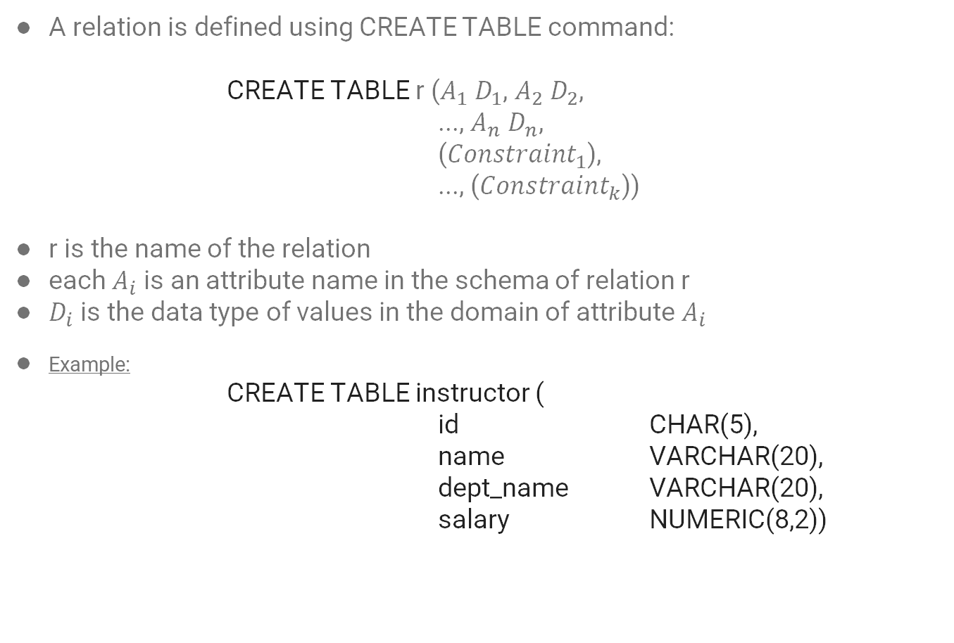
Table Creation
A relation is defined using CREATE TABLE command:
CREATE TABLE r ($A_{1}$ $D_{1}$, $A_{2} D_{2}$,
..., $A_{n}$ $D_{n}$,
(${Constraint}_{1}$),
..., (${Constraint}_{k}$))
r is the name of the relation
each $A_{i}$ is an attribute name in the schema of relation r
$D_{i}$ is the data type of values in the domain of attribute $A_{i}$
Example:
CREATE TABLE instructor (
id CHAR(5),
name VARCHAR(20),
dept_name VARCHAR(20),
salary NUMERIC(8,2))

Slide 6
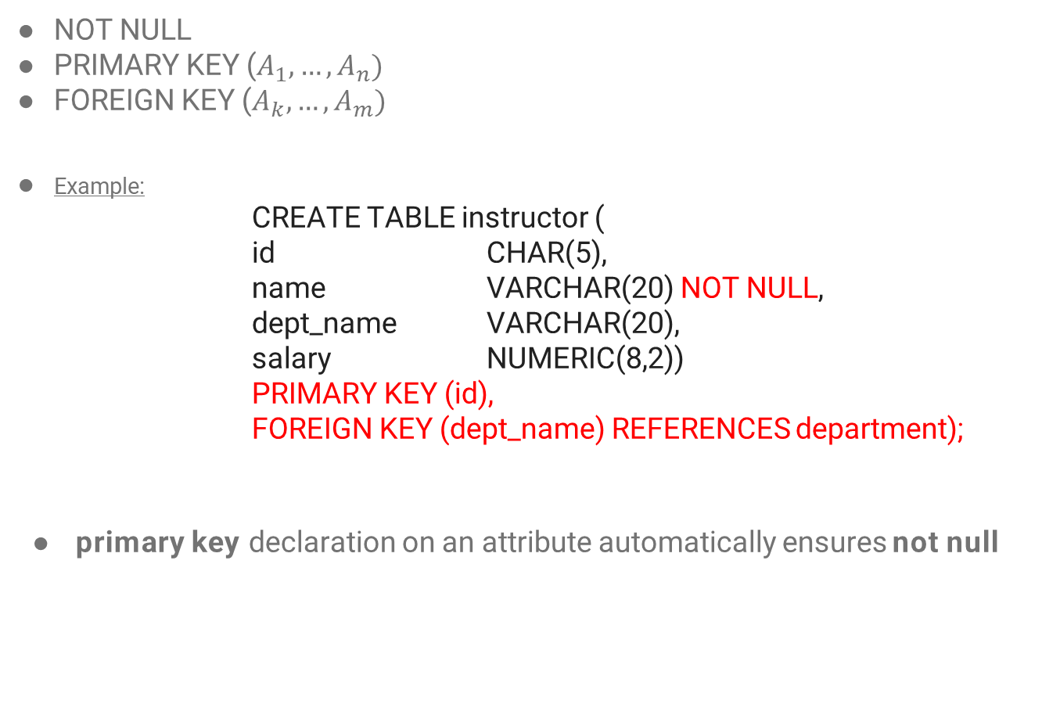
Table Creation – Integrity Constraints
NOT NULL
PRIMARY KEY ($A_{1}, …,A_{n})$
FOREIGN KEY ($A_{k}, …,A_{m})$
Example:
CREATE TABLE instructor (
id CHAR(5),
name VARCHAR(20) NOT NULL,
dept_name VARCHAR(20),
salary NUMERIC(8,2))
PRIMARY KEY (id),
FOREIGN KEY (dept_name) REFERENCES department);
primary key declaration on an attribute automatically ensures not null

Slide 7
Recap

Slide 8
Table Creation – Example
CREATE TABLE department(
dept_name VARCHAR(20),
building VARCHAR(15),
budget NUMERIC(12,2),
PRIMARY KEY (dept_name));
CREATE TABLE course(
course_id VARCHAR(8),
title VARCHAR(50),
dept_name VARCHAR(20),
credits NUMERIC(2,0),
PRIMARY KEY (course_id),
FOREIGN KEY (dept_name) REFERENCES department);

Slide 9
Table Creation – Example
CREATE TABLE takes(
id VARCHAR(5),
course_id VARCHAR(8),
sec_id VARCHAR(8),
semester VARCHAR(6),
year NUMERIC(4,0),
grade VARCHAR(2),
PRIMARY KEY (id, course_id, semester, year),
FOREIGN KEY (id) REFERENCES student,
FOREIGN KEY (course_id, sec_id, semester, year), REFERENCES section);
Notes:
Do you know what will happen if we add sec_id to primary key?
Then a student can register to two sections of the same course in the same semester.

Slide 10
Update Tables
INSERT
INSERT INTO instructor VALUES (‘10211’, ’Smith’, ’Biology’, 66000);
DELETE
DELETE FROM student;
DROP
DROP TABLE student
ALTER
ALTER TABLE r ADD A D
ALTER TABLE r DROP A
Notes:
alter table r add A D
where A is the name of the attribute to be added to relation r and D is the domain of A.
All exiting tuples in the relation are assigned null as the value for the new attribute.
alter table r drop A is on paper
PostgreSQL doesn’t support that

Slide 11
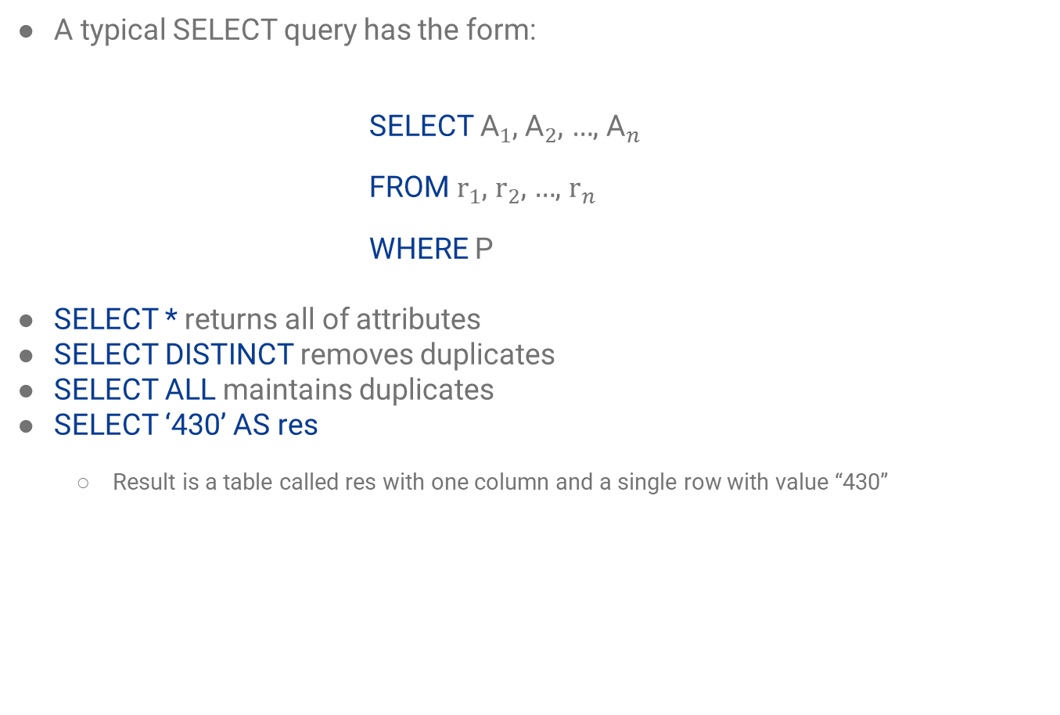
SELECT Query
A typical SELECT query has the form:
SELECT ${\text{A}}_{1}$, ${\text{A}}_{2}$, $…$, ${\text{A}}_{n}$
FROM ${\text{r}}_{1}$, ${\text{r}}_{2}$, $…$, ${\text{r}}_{n}$
WHERE P
SELECT * returns all of attributes
SELECT DISTINCT removes duplicates
SELECT ALL maintains duplicates
SELECT ‘430’ AS res
Result is a table called res with one column and a single row with value “430”
Notes:
SQL names are not case sensitive
${\text{A}}_{i}$ represents an attribute
${\text{R}}_{i}$ represents a relation
P is a predicate
Select in relational algebra vs. Select in SQL
Select clause can contain arithmetic expressions involving the operation, +, –, *, and /
select ID, name, salary/12 as monthly_salary
Select name from instructor
where dept_name = ‘Comp. Sci.
and, or, and not
select name
from instructor
where dept_name = ‘Comp. Sci.' and salary > 70000
Listing relations is equivalent of cartesian product which is not very useful without conditions

Slide 12
SELECT Example
SELECT name, course_id
FROM instructor, teaches
WHERE instructor.id = teaches.id

Slide 13
SELECT Example
Relation supervision:
Find the supervisor of the supervisor of “Bob”

Slide 14
SELECT Example
Relation supervision:
Find the supervisor of the supervisor of “Bob”
SELECT B.supervisor
FROM supervision AS A, supervision AS B
WHERE A.supervisor = B.person AND A.person = ‘Bob’

Slide 15
Pattern Matching
% character matches any substring
_ character matches any character
SELECT name
FROM instructor
WHERE name LIKE ‘%dar%’
Match using escape character:
LIKE ‘100\%’ ESCAPE ‘\’
Patterns are case sensitive
https://www.postgresql.org/docs/current/functions-matching.html

Slide 16
String Operations
|| allows concatenation
CHAR_LENGTH() will show string length
LOWER() will convert the string to lower case
UPPER() will convert the string to upper case
https://www.postgresql.org/docs/current/functions-string.html

Slide 17
Sorting
We can sort the result of our query using ORDER BY
SELECT DISTINCT name
FROM instructor
ORDER BY name
Sorting is ascending by default (ASC) and we can use (DESC) to see descending order.
It can handle multiple attributes

Slide 18
WHERE Pridicates
We can use BETWEEN to specify a range for our attribute
SELECT name
FROM instructor
WHERE salary BETWEEN 90000 AND 100000
We can use tuple comparison
SELECT name, course_id
FROM instructor, teaches
WHERE (instructor.id, dept_name) = (teaches.id, ‘Biology’)
Notes:
IS NULL can be a pridicate

Slide 19
Set Operations
Set operations include UNION, INTERSECT, and EXCEPT
Each of the operations above automatically eliminates duplicates.
We can use UNION ALL, INTERSECT ALL, etc. to avoid that elimination.
(SELECT DISTINCT salary
FROM instructor)
EXCEPT
(SELECT DISTINCT T.salary
FROM instructor AS T, instructor AS S
WHERE T.salary < S.salary)
Notes:
This is not the best way to do it

Slide 20
Aggregate Functions
These functions operate on the columns and return a value:
AVG: Average value
MIN: Minimum value
MAX: Maximum value
SUM: Sum of values
COUNT: Count of values

Slide 21
Aggregate Functions
These functions operate on the columns and return a value:
AVG: Average value
MIN: Minimum value
MAX: Maximum value
SUM: Sum of values
COUNT: Count of values
All aggregate functions except COUNT(*) ignore tuples with null values on the aggregated attributes.
Notes:
select count (*) from course;
select count (distinct ID) from teaches where semester = ’Spring’ and year = 2010;
select avg (salary) from instructor where dept_name= ’Comp. Sci.’;

Slide 22
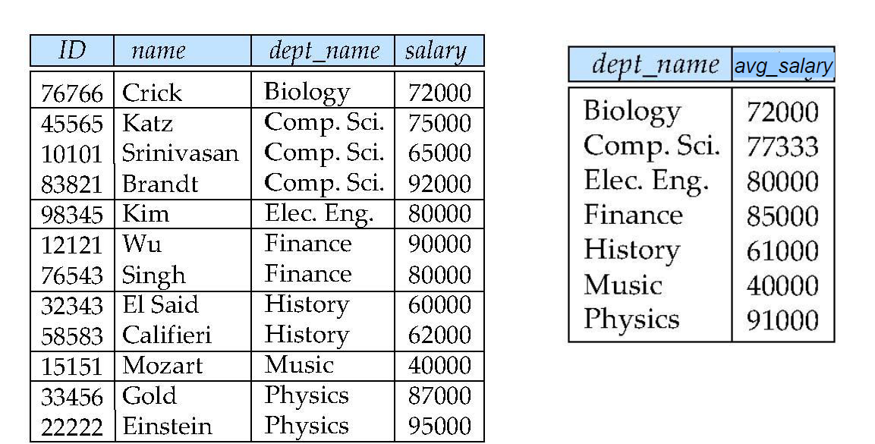
Aggregate Functions – Example
Find the average salary of instructors in each department

Slide 23
Aggregate Functions – GROUP BY
Find the average salary of instructors in each department
SELECT dept_name, AVG (salary) AS avg_salary
FROM instructor
GROUP BY dept_name
Notes:
Remove Music since it is below 40000

Slide 24
Aggregate Functions – HAVING
Find the average salary of instructors in each department and show the results above 40,000.
SELECT dept_name, AVG (salary) AS avg_salary
FROM instructor
GROUP BY dept_name
HAVING avg_salary > 40000;

Slide 25
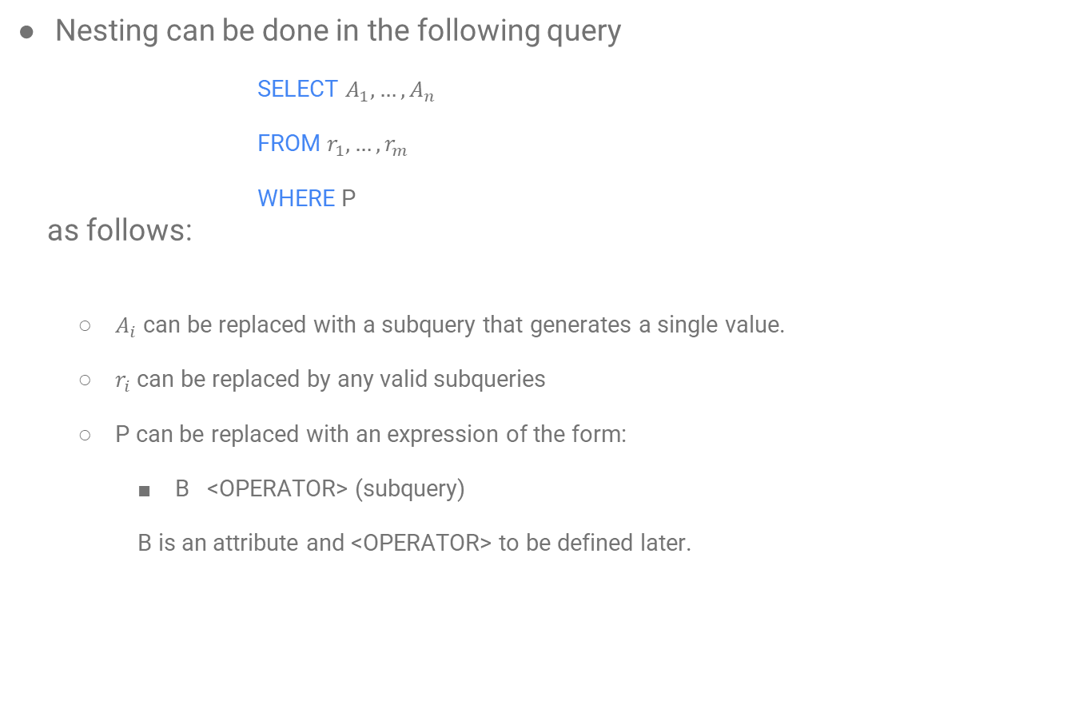
Nested Subqueries
Nesting can be done in the following query
SELECT $A_{1},…,A_{n}$
FROM $r_{1},…,r_{m}$
WHERE P
as follows:
$A_{i}$ can be replaced with a subquery that generates a single value.
$r_{i}$ can be replaced by any valid subqueries
P can be replaced with an expression of the form:
B <OPERATOR> (subquery)
B is an attribute and <OPERATOR> to be defined later.

Slide 26
WHERE Subqueries
A common use of subqueries is to perform tests:
For set membership
For set comparisons
For set cardinality
Notes:
set cardinality deals with the number of elements in a set.

Slide 27
Set Membership
Find courses offered in Fall 2020 and in Winter 2021
SELECT DISTINCT course_id
FROM section
WHERE semester = ‘Fall’ AND year = 2020 AND
course_id IN (SELECT course_id
FROM section
WHERE semester = ‘Winter’ AND year = 2021);
Notes:
We can use NOT IN as well.

Slide 28
ANY vs. ALL
Find the name of the instructors with a salary greater than at least one instructor in the Biology department.
SELECT DISTINCT name
FROM instructor
WHERE salary > ANY (SELECT salary
FROM instructor
WHERE dept_name = ‘Biology’);
Find the name of the instructors with a salary greater than all of the instructors in the Biology department.
Notes:
We can use NOT IN as well.
= ANY ≡ IN
<> or != ANY is not equivalent with NOT IN
<> or != all ≡ NOT IN
= all is not equivalent with IN

Slide 29
EXISTS
EXISTS keyword checks if the subquery has any elements.
SELECT course_id
FROM section AS S
WHERE semester = ‘Fall’ AND year = 2020 AND
EXISTS(SELECT *
FROM section AS T
WHERE semester = ‘Winter’ AND year = 2021
AND S.course_id = T.course_id);
Notes:
What does it do?
Again, we can use NOT EXISTS as well

Slide 30
References
Database System Concepts - 6th edition (db-book.com)

